Slide 1
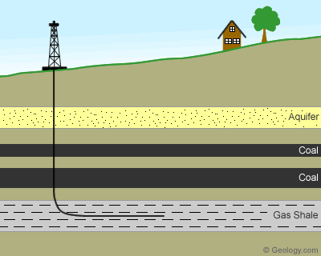
SPLIT
_____________________________
ESTATES
www.bredl.org

Slide 2
What is a split (or severed) estate?
“Split Estate - The concept of Split Estate dates back to English law, which reserved the mineral rights of all land, public and private to the king. Over time, Split Estate has come to be defined as a situation in which a property owner is not the same party who owns the rights to extract minerals from underneath the property. In fact, especially in the Western states, surface owners rarely own their mineral rights, and the party who does own them, is entitled to extract them, even if the surface owner doesn't want them to.” http://www.splitestate.com/fracking.html
It is estimated that there are 0ver 7000 acres of Split Estates in Lee County

Slide 3
What protections do citizens with split estates have?
At this time there are essentially no laws regulating severed estates and the treatment of surface owners.

Slide 4
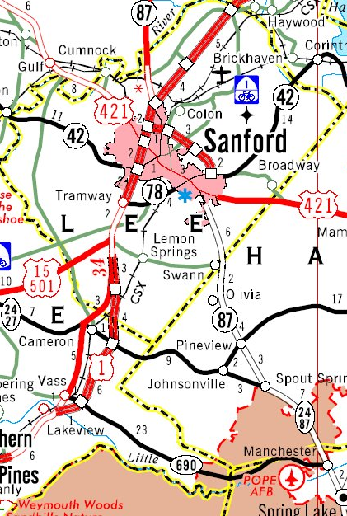
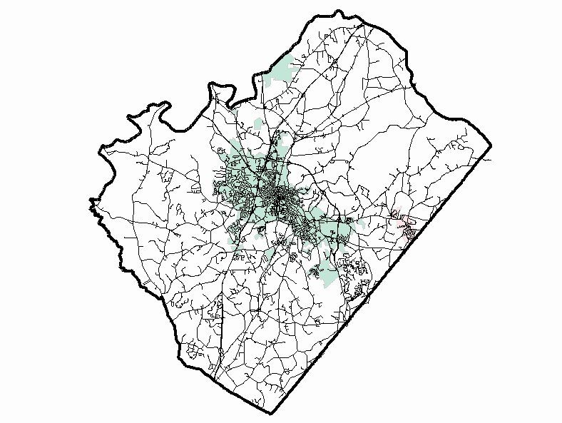
Lee County NC Map from Lee County GIS Strategic Services
Lee County NC Road Map from NC DOT

Slide 5
Do You Own Your Mineral Rights?
Map of Lee County NC Showing Leased Land from Lee County GIS Strategic Services

Slide 6
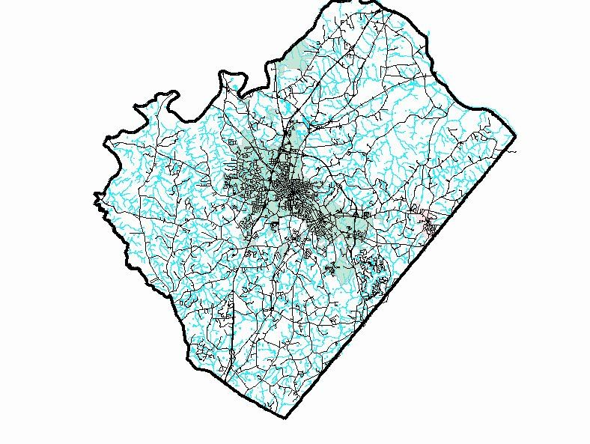
Map of Lee County NC Showing the Hydrography from Lee County GIS Strategic Services

Slide 7
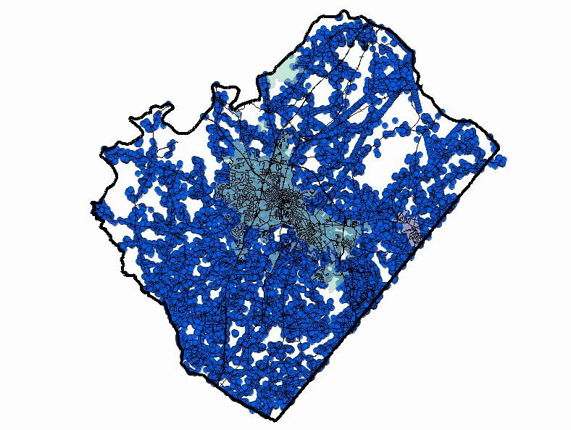
Map of Lee County Showing Residential Properties from Lee County GIS Strategic Services

Slide 8
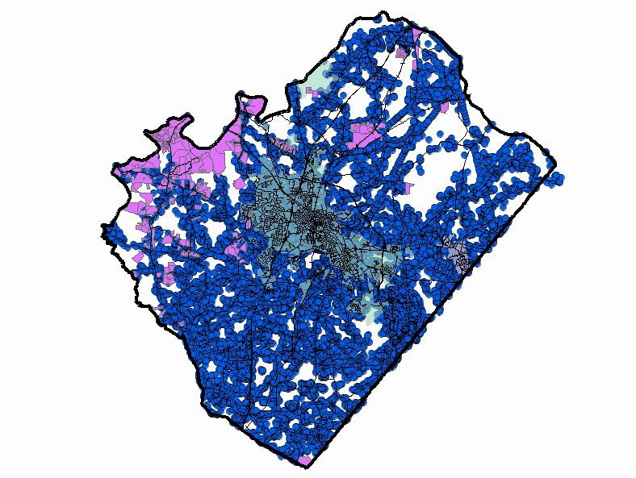
Map of Lee County Showing NC Residential Property Overlaid With Leased Land from Lee County GIS Strategic Systems

Slide 9
Close ups of some of the leased mineral rights in Lee County NC
The red “1” in the yellow dot is 957 Cumnock Rd

Slide 11
How do I find out who owns my mineral rights?
Contact your register of deeds for assistance
Mollie A. McInnis Lee County Register Of Deed
Lee County Courthouse 1408 S. Horner Blvd P.O. Box 2040 Sanford, NC 27330 8:00am - 5:00pm Mon - Fri (919)718-4585
Remote search site: http://www.leencrod.org/

Slide 12
How do I find out who owns my mineral rights? (continued)
Contact Lee County GIS Strategic Services
Don Kovasckitz Director
dkovasckitz@leecountync.gov
Summit Building 408 Summit Drive Sanford, NC 27330
Link to interactive map

Slide 13
OR you could contact a lawyer...
You could start with a simple title search, but complex mineral deed searches can be quite expensive

Slide 14
Thank you for your attention! The movie Split Estate is a very powerful film. It is available on Netflix, I also have a copy and can arrange a showing for your group if you are interested.
Therese Vick - Blue Ridge Environmental Defense League therese.vick@gmail.com www.bredl.org

